Slide 1
Dermatology
Kwasi Collins

Slide 2
SKIN
The skin is an organ that is involved in excretion, regulation, protection and sensory input in the human body.
The integuments include the skin, hair, nails and various glands.
The diseases affecting the other integuments are mainly communicable diseases .
The skin has three layers;
1. The Epidermis
The epidermis is the outermost layer. It is thin and is nourished from diffused nutrients and oxygen. It is composed of stratified epithelium, which varies in thickness and is composed of …

Slide 3
CONT…
five layers. Dead cells from the outermost layer slough off and are replaced by others
2. The Dermis
The dermis is the second layer of the skin. It has blood vessels, nerves, lymphatic vessels, hair follicles, involuntary muscle fibres, glands and collagen fibres. It is the collagen that gives the skin its elasticity. The dermis is divided into two layers. These are the upper papillary layers and the lower reticular layers.
3. Subcutaneous Tissues
This is mainly composed of adipose tissue. It attaches the skin to underlying structures.

Slide 4
CONT…
Functions of the Skin
List at least five functions of the skin.
Disorders of the Integuments
Some disorders that can afflict the skin are: eczema, psoriasis, and tumors of the skin.

Slide 5
SKIN LESIONS
When these are observed they should be described in terms of type, colour, size, shape, configuration and arrangement, distribution and texture.
Type
Proper description terminology should be used for clear accurate communication about skin lesions, for example the term vesicle provides a clear picture of a lesion that is clear, fluid filled and smaller than 1cm.
Colour
This varies from pale, brown, red to normal background pigmentation.
Colour helps to identify whether the lesion may be secondary to an inflammatory process, infection, and sun exposure or hereditary.

Slide 6
CONT…
Size
The metric system is used for measurement, but where a ruler is not available the size of a lesion may be estimated by measuring a portion of ones finger to use a gauge.
Shape and Demarcation
Shape describes the contour of a lesion and this may be round, oral, polygonal (many sided) and asymmetric. Demarcation refers to the sharpness of the edge of a lesion, whether discrete or diffuse.

Slide 7
CONT…
Texture
The lesion is described as being rough or smooth, dry or moist and on the surface, or deeply penetrating into the tissue.
Configuration
Refers to the arrangement or pattern of lesions in relation to other lesions. Skin lesions can occur discretely or in groupings.
The groupings may be termed as linear, following a line, annular, ring like, confluent, merging together, or serpiginous, serpent like, while disseminated refers to multiple scattered lesion diffusely distributed over the body.

Slide 8
CONT…
Distribution
This takes into consideration both the arrangement of lesions over an area of skin as well as the pattern. This may be described as discrete (isolated), localised, regional and generalised.
Diagnostic Tests
Most skin disorders are diagnosed by careful physical assessment. Diagnostic tests may be used when further information is required to confirm the diagnosis.

Slide 9
CONT…
Other tests may include: Laboratory Tests • Tzanck prep test: The test can be used to further differentiate sign disorders that produce vesicles or blisters. The blister is unroofed with a cotton swab or blade and the base of the vesicle is seraped to obtain cells for examination. Potassium hydroxide (KOH) prep test: The test is done if fungal infection is suspected to assist in the identification of the fungal forms. Dry scale is scraped from the lesion and put on a slide. One or two drops of 20% KOH are placed onto the slide and gently heated.

Slide 10
Impetigo

Slide 11
Impetigo
staphylococci or streptococci infection with a rash progressing from red macules to pustules to weeping yellow crusts, involves areas on the face and extremities, any age may be affected but most common in children.
Both bacteria are part of the normal flora of our skin.

Slide 12
Bacterial Infections
1) Staph. and/or Strept.
Infections
2) Streptococcal
infections
3) Infection Of The
Hair Follicle

Slide 13
Clinical forms/types
Bullous impetigo (formation of vesicles)
Non bullous impetigo or impetigo contagiosa (formation of vesicles).

Slide 14
Types
Bullous type
Non bullous type
vesicular impetigo
Circinate impetigo
Crusted impetigo

Slide 15
Pathophysiology
The lesions begin as small red vesicles which then raptures releasing serum which coagulates forming honey yellow crusts. These crusts are easily removed leaving smooth red moist surface on which near crust soon develop.

Slide 16
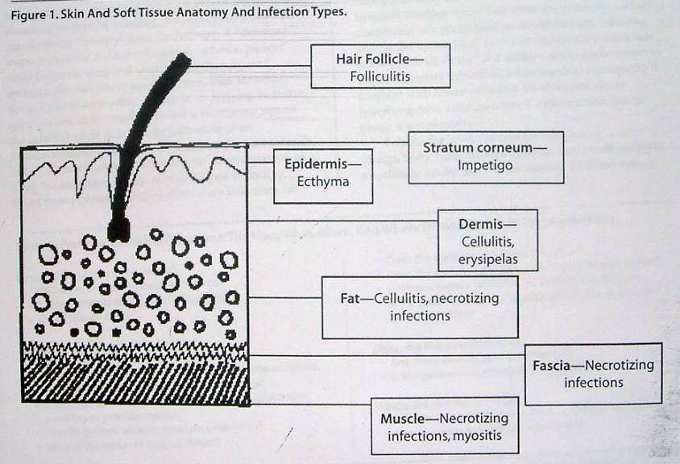

Slide 17
Mode of transmission
It is highly contagious skin disease and can spread by direct contact with lesions or may be spread indirectly with freshly contaminated materials.
The disease may be primary or secondary to pediculosis carpitis, scabies, herpes simplex, insect bite, ecyzema.

Slide 18
Clinical features
Slightly itching of the affected area
Lymphadenopathy
General malaise
Fever
1ry lesion: vesicle
Crust is formed when the lesion becomes dry.

Slide 19
Diagnosis
Culture
Gram staining

Slide 20
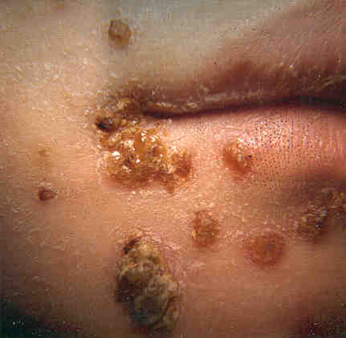
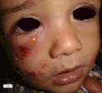
Impetigo

Slide 21
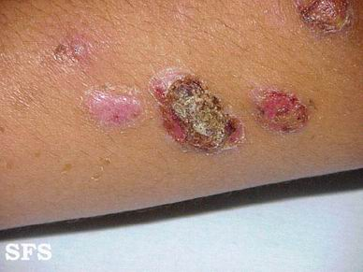
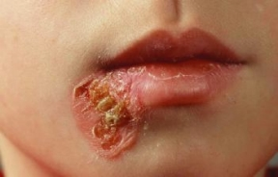

Slide 22
Nursing Management
The nurse instructs the patient and family members to bathe at least once daily with bactericidal soap.
Cleanliness and good hygiene practices help prevent the spread of the lesions from one skin area to another and from one person to another.
Each person should have a separate towel and washcloth.
Because impetigo is a contagious disorder, infected people should avoid contact with other people until the lesions heal.

Slide 23
Management
Treatment of predisposing causes: e.g. pediculosis & scabies.
Remove the crusts: by olive oil or hydrogen peroxide.
Topical antibiotic: e.g. tetracycline, bacitracin, gentamycin, mupiracin (Bactroban®), Fusidic acid (Fucidin®).Antiseptic baths such as potassium permanganate.

Slide 24
Systemic antibiotics are indicated especially in the presence of fever or lymphadenopathy, in extensive infections involving scalp, ears, eyelids or if a nephritogenic strain is suspected, e.g. penicillin, erythromycin & cloxacillin.
Azithromycin (Zithromax®) 2 caps 500 mg daily for 3 days in adults.
In erythromycin-resistant S. aureus: amoxicillin + clavulanic a. (Augmentin®) 25 mg/kg/day.

Slide 25
Complications
Glomerulonephritis: due to beta- hemolytic Streptococci
Cellulitis.
Scalded skin syndrome: due to exotoxins of Staph aureus
Scarlet fever .

Slide 26
Health education
Instruct patient to bath once a day with bactericidal soap.
Infected child should be isolated.
Towels and clothes should not be shared.

Slide 27
Acne Vulgaris

Slide 28
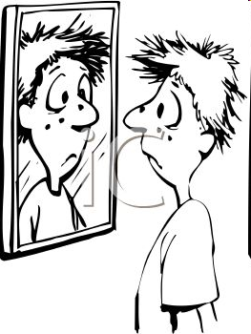
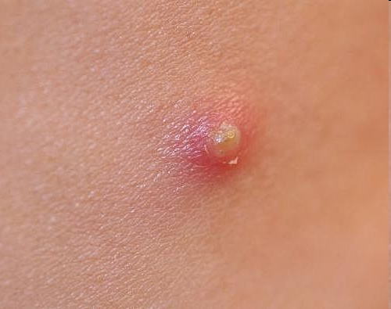
Acne Vulgaris
Acne is a skin condition characterized by whiteheads, blackheads, and inflamed red pimples or "zits."
Microorganism is Propionibacterium acnes ~ Disease is called ACNE.
Acne is follicle-associated lesions from isloated pimples to widespread acne.

Slide 29
Incidence
Commonly affects people between ages12-25yrs but more marked in puberty due to activities of endocrine glands.
Girls develop acne 2-3yrs earlier than boys have more persistent lesions.

Slide 30
Pathophysiology
In neonates, small visible sebaceous glands are often on the central panel of the face due to stimulation by maternal androgens.
Sebaceous glands then become inactive until puberty when the individual starts releasing androgens causing expansion of the sebaceous gland and also there is increased production of sebum. If sebum is in excess, it accumulates in the hair follicles and form plugs known as commedones which have black or white heads. The lesions may be closed or opened leading to inflammation to papules, nodules, pastules or abscess.

Slide 31
If acne has been severe and persistent for sometime leading to rupture of follicles , there may be scarring.

Slide 32
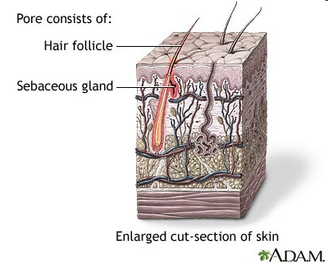
Predisposing factors
Sebaceous Glands
Blockage of pores= sebum and dead cells trapped get clogged at the pores.
Overproduction of sebum through hormones (especially in males)

Slide 33
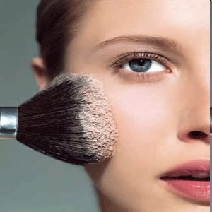
Triggered by: greasy or oily cosmetic products.
Certain drugs like steroids, testosterone, and estrogen
High levels of Humidity and sweating

Slide 34
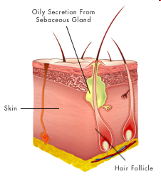
Causative agent
Acne tends to run in familes
Hormonal factors e.g. androgens
Bacteria is anaerobic aerotolerant, and gram positive. It releases enzymes, most important lipase

Slide 35
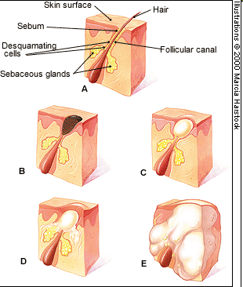
Signs and Syptoms
Blackheads (plugged with dark sebum)
Crusting of skin
Cysts
Inflamation around the skin
Abscesss
Pappules
Pastules
Scarring on skin
Whiteheads (pore closed~comedo)

Slide 36
Aggreviating factors
Cosmetics-cleansing cream
Pricking or scrubbing with medicated soap
Hormones at teenage or pregnancy

Slide 37
Assessment and Diagnostic Findings
The diagnosis of acne is based on the history and physical examination, evidence of lesions characteristic of acne, and age. Acne does not occur until puberty. The presence of the typical comedones (ie, whiteheads and blackheads) along with excessively oily skin is characteristic.
Women may report a history of ﬂare-ups a few days before menses. Biopsy of lesions is seldom necessary for a deﬁnitive diagnosis.

Slide 38
Nursing Management
Nursing care of patients with acne consists largely of monitoring and managing potential complications of skin treatments.
Major nursing activities include patient education, particularly in proper skin care techniques, and managing potential problems related to the skin disorder or therapy.

Slide 39
CONT…
In addition to receiving instructions for taking prescribed medications, patients are instructed to wash the face and other affected areas with mild soap and water twice each day to remove surface oils and prevent obstruction of the oil glands.
They are cautioned to avoid scrubbing the face
All forms of friction and trauma are avoided, including propping the hands against the face, rubbing the face, and wearing tight collars and helmets.
Patients are instructed to avoid manipulation of pimples or blackheads.

Slide 40
Treatment
1. Control of sebum production/accumulation
Administration of anti-androgens usually oestrogen can reduce sebum production e.g. combined oral contraceptives (not for men).
Benzyl peroxide 5-10% get applied locally breaks down commedones (yellow and black heads) and also has anti-bacterial properties.

Slide 41
2. Control of bacterial load
Prolonged administration of tetracycline ; 0.5-1gm o.d. for 4weeks then reduced to 0.25-0.5mg o.d.
Erythromycin same dose can be given
3. Control of excess keratinized of hair follicles.
Vitamin A in form of Retin A lotion of 0.05%- 0.1% reduces keratinization
It has irritants’ drying an peeling properties.
Combination of Retin A cream and Benzyl peroxide improve the results. Systematic corticosteroids may be used

Slide 42
Incision and drainage (I & D) for large boils and appropriate antibiotics given.

Slide 43
Eczema

Slide 44
Introduction
A general term used to describe superficial inflammatory skin condition involving epidermis.
It is a chronic allergy to an ingested substance, often milk, that results to reddish weeping scaly crusts form.
It usually involves head, face, neck, seen most often in infants and young children.

Slide 45


Slide 46
Causes
Idiopathic but associated with:
Common irritant like dyes, chemicals, green vegetation, food stuff.
Allergic disease like asthma and hay fever.

Slide 47
Types of eczema
Infantile eczema
Traumatic eczema
Traumatic eczema
Miliaric (milk spot eczema)
Hands and feet eczema
Nummular eczema

Slide 48
Infantile eczema
Occurs to infants 3-4 months, mainly manifested in the face and scalp.
Predisposing factors
Dryness of the skin due to defective functions of the sebaceous gland
Excessive moisture from sweating at the groins and breast.
Hereditary
Allergy e.g. to drugs

Slide 49
Clinical features
Erythematous skin with itching and burning sensation
Vesicles then appear and start oozing
Formation of crust as exudates dries
Pus formation in case of secondary infection
Cracking and fissuring may occur
Thickening of the skin as cells multiply

Slide 50
Traumatic eczema
Erythema arising due to trauma by pricking and irritating materials/objects.
Miliaric (milk spot eczema)
Occur in infants aged between 4-6weeks
The baby comes int0 contacts with irritating environmental material and put into mouth.
These spots develop around the nose and the mouth. They develop as pin head pastules.

Slide 51
Hands eczema
Lesions caused by external irritants, detergents or shoe polish or can be due to a fungal infection.
The skin cracks causing deep fissure that bleed on scratching.
Numular eczema
A chronic itchy lesion which ocuurs in coin shapes 4-10cm in diameter on the legs.

Slide 52
Characteristics of eczema
Lesion start as an erythema (reddening of the skin) then painful lesion is formed.
Skin rashes are distributed at the fields of the arms, elbows, knees and face.
The vesicles ooze fluid (weeping vesicles) and dries leaving crusts.
In chronic stage, the following are noted:
Drying and scaling lesions with thickening and pigmentation of the skin
Itching lesion
Secondary infection if no Rx and may start oozing.

Slide 53
Management
Remove all suspected irritants
Clean and dry the lesions area aseptically to prevent secondary infection.
Apply skin soothing ointment daily e.g. Vaseline
Give analgesics to relieve pain
Sedate patient to alley anxiety and bed rest is necessary
Oral antibiotics to prevent secondary infection
Antihistamine e.g. piriton tabs 4mgs 8hrly to stop itching.
Reassure the patient and provide psychological care.

Slide 54
Seborrheic Dermatitis

Slide 55
Definition
Seborrhea is excessive production of sebum in areas where sebaceous glands are normally found in large numbers, such as the face, scalp, eyebrows, eyelids, sides of the nose and upper lip, malar regions (ie, cheeks), ears, axillae, under the breasts, groin, and gluteal crease of the buttocks.

Slide 56
Cause
Unknown but associated with pityrosporium fungi

Slide 57
Predisposing factors
Genetic factors
Hormonal problems
Poor nutritional status
Poor hygiene

Slide 58
Clinical Manifestations
Two forms of seborrheic dermatoses can occur, an oily form and a dry form.
The oily form appears moist or greasy.
The scalp is affected first and there’s diffuse erythema
There may be patches of sallow, greasy skin, with or without scaling, and slight erythema, predominantly on the forehead, nasolabial fold, beard area, scalp, and between adjacent skin surfaces in the regions of the axillae, groin, and breasts.
Small pustules or papulopustules resembling acne may appear on the trunk

Slide 59
Cont…
The dry form
Consist of ﬂaky desquamation of the scalp with a profuse amount of ﬁne, powdery scales, is commonly called dandruff.
The mild forms of the disease are asymptomatic. When scaling occurs, it is often accompanied by pruritus, which may lead to scratching and secondary infections and excoriation.

Slide 60
Medical Management
The objective of therapy is to control the disorder and allow the skin to repair itself.
The mainstay of dandruff treatment is proper, frequent shampooing (daily or at least three times weekly) with medicated shampoos.
Topically steroid and antifungal cream help allays the secondary inﬂammatory response or symptoms.
Systemic antibiotics may be given to prevent secondary bacterial infection.
Treatment of choice is ketoconazole cream or clotrimazole cream.
Apply calamine lotion to remove erythema.

Slide 61
Nursing Management
A person with seborrheic dermatitis is advised to :
avoid external irritants, excessive heat, and perspiration; rubbing and scratching prolong the disorder.
To avoid secondary infection, the patient should air the skin and keep skin folds clean and dry.
Instructions for using medicated shampoos are reinforced for those with dandruff that requires treatment.

Slide 62
Cont…
Patients need to be encouraged to adhere to the treatment program.
Those who become discouraged and disheartened by the effect on body image should be treated with sensitivity and an awareness of their need to express their feelings.

Slide 63
Health Education
Avoid excess heat
Remove external irritants
Avoid scratching
Keep skin fold clean and dry to avoid secondary infection.

Slide 64
Herpes Zoster

Slide 65
Introduction
Herpes zoster, also called shingles or zona, is an infection caused by the varicella-zoster virus, a member of a group of DNA viruses.
The viruses causing chickenpox and herpes zoster are indistinguishable, hence the name varicella-zoster virus.
The disease is characterized by a painful vesicular eruption along the area of distribution of the sensory nerves from one or more posterior ganglia.
Incubation period is between 1-3 weeks depending on immunity.

Slide 66
Mode of spread
The virus is spread through direct contact with droplets from a person with chickenpox ;after the individual suffers from chickenpox, the virus follows the nerve and settles at the root of the nerve.
In case of any decrease in immunity, the virus attacks the nerve endings leading to severe pain and shingles on the skin.

Slide 67
Areas affected
Face due to trigeminal nerve infection
Abdomen
Trunk

Slide 68
Clinical Manifestations
The eruption is usually accompanied or preceded by pain, which may radiate over the entire region supplied by the affected nerves.
Malaise and fever and linear erythematous band develop following the prodromal pain.
Groups of small blisters then develop on the erythema.
There is burning and itching pain and tenderness.
The early vesicles, which contain serum, later may become purulent, rupture, and form crusts.

Slide 69
Diagnosis
Use a dermatological pattern map to visualize a rash that appears.
Laboratory tests. VZV-specific IgM antibody in blood.
Polymerase chain reaction for VZV DNA in lymph collected from the blister or electron microscope for virus particles.

Slide 70
Medical Management
The goals of herpes zoster management are to relieve the pain and to reduce or avoid complications, which include infection, scarring, and postherpetic neuralgia and eye complications.
In severe cases, patient is admitted and put on complete bed rest.
Pain is controlled with analgesics
Systemic corticosteroids may be prescribed for patients older than age 50 years to reduce the incidence and duration of postherpetic neuralgia.
Antiviral treatment with oral acyclovir 800mg for 5-7 days is given, to suppress the virus.

Slide 71
Incase of trigeminal nerve involvement, ophthalmology review of the involved eye and ENT review is important.
Given plenty of fluids to replace fluid loss by blisters.
Apply soothing and dry topical e.g. povidone iodine and oily calamine lotion.

Slide 72
Nursing Management
The nurse assesses the patient’s discomfort and response to medication and collaborates with the physician to make necessary adjustments to the treatment regimen.
The patient is taught how to apply wet dressings or medication to the lesions and to follow proper hand hygiene techniques to avoid spreading the virus.
Diversionary activities and relaxation techniques are encouraged to ensure restful sleep and to alleviate discomfort.
Clean the area aseptically and keep it dry.

Slide 73
Complications
Aseptic meningitis
Partial facial paralysis
Ear damage
Zoster sine herpte

Slide 74
Herpes Simplex

Slide 75
Introduction
Also know as cold sores
Herpes simplex type 1 occurs on the mouth and type 2 in the genital area, but both viral types can be found in both locations.
About 85% of adults worldwide are seropositive for herpes type 1. The prevalence of type 2 is lower; type 2 usually appears at the onset of sexual activity.

Slide 76
Classification
Herpes simplex is classiﬁed as a true primary infection, a nonprimary initial episode, or a recurrent episode.
True primary infection is the initial exposure to the virus.
A nonprimary initial episode is the initial episode of type 1 or type 2 in a person previously infected with the other type.
Recurrent episodes are subsequent episodes of the same viral type.

Slide 77
Mode of transmission
Direct contact with fluid exudates from the blisters
Causative organism
Herpes simplex virus type I causes sores on the lips and mouth
Herpes simplex virus II causes perineal and cervical lesion.
Incubation
4-5 days

Slide 78
Predisposing factors
Trauma
Menstruation due to wetness in cervix
Cold/sunlight
Bacterial infection
Other viral infection
Respiratory tract infection

Slide 79
Signs and symptoms
Burning sensation 24-45 hours post-infection
Itchy blisters appear after 48hours accompanied by pain the painful red edematous areas in the body.
Vesicle start as pimple then rupture leading to superficial sores, painful and oozing.
Crusts from sores
High temperatures of between 37.5 to 38oc
General malaise and headache
Dysuria in case of genitalia sores
Purulent p.v. discharge in case of cervical sores
Enlarged lymph nodes

Slide 80
Assessment and Diagnostic Findings
Generally, the appearance of the skin eruption is strongly suggestive.
Viral cultures and rapid assays are available
The type of test used depends on lesion morphology.

Slide 81
Medical Management
Those with recurrent orolabial herpes should use a sunscreen liberally on the lips and face.
Topical treatment with drying agents may accelerate healing.
Give Acyclovir (zovivax) 200mg O.D. x 5 days orally to prevent further spread but carefully observe for side effects e.g. headache, rashes, insomnia, muscle cramps, sore throat.
Apply ice cubes to the affected area for 20mins 6hrly to relieve pain.
Allow bed rest due to general malaise, dysuria and pain over affected area.

Slide 82
Cont…
Sitz baths to give comfort in genital infection
Eczema herpeticum is managed with oral or intravenous acyclovir.
Genital herpes in pregnancy is controversial. Suppression therapy should be started in these women to reduce outbreaks during the third trimester.
In immunocompromised patients, suppression therapy should be considered. In severe infections of the hospitalized patient, intravenous acyclovir is prescribed.

Slide 83
Nursing Management
Reassure the patient
Advise on cleanliness and proper hygiene
Advise on diet rich in vitamins and proteins
Health education especially on mode of spread
Advise on frequent emptying of bladder in case of genital urinary involvement.

Slide 84
Complications
Eczema herpeticum is a condition in which patients with eczema contract herpes that spreads throughout the eczematous areas.
Herpes Whitlow is an infection of the pulp of a ﬁngertip with herpes type 1 or 2.
Fetal anomalies include skin lesions, microcephaly, encephalitis, and intracerebral calciﬁcations.

Slide 85
PSORIASIS

Slide 86
Introduction
A chronic noninfectious inﬂammatory disease of the skin in which epidermal cells are produced at a rate that is about six to nine times faster than normal.
The cells in the basal layer of the skin divide too quickly, and the newly formed cells move so rapidly to the skin surface that they become evident as profuse scales or plaques of epidermal tissue.

Slide 87
Occurrence
Affects all ages but common in 10-35 yrs.
Cause
Unknown but affiliated with:
Genetic factor-in families
Precipitated by stress, trauma, anxiety, hormonal changes, ultra violet radiation, alcohol and smoking.

Slide 88
Classification
Classic plaque psoriasis
Guttate/rain drop Psoriasis
Seborrhoeic Psoriasis
Erythrodermic Psoriasis
Pustular Psoriasis
Scalp Psoriasis
Nails Psoriasis
NB: Discuss each

Slide 89
Clinical Manifestations
Lesions appear as red, raised patches of skin covered with silvery scales. The scaly patches are formed by the buildup of living and dead skin resulting from the vast increase in the rate of skin-cell growth and turnover
The lesions are circular and irregular.
There are silvery dry and detachable scales that bleed on scratching.
Normal lesions are distributed on the elbows, scalp, knees sacral region but later spread to other body parts.
Alopecia if scalp is affected.
If the attack are on the nails, there is pitting, discoloration, crumbling beneath the free edges, and separation of the nail plate.

Slide 90
Areas commonly affected
Scalp
Extensor part of elbows and knees
Soles and pain
Face, Ears
Genitalia, Nail
Sacrum and intergluteal folds

Slide 91
Assessment and Diagnostic Findings
The presence of the classic plaque-type lesions generally conﬁrms the diagnosis of psoriasis.
Because the lesions tend to change histologically as they progress , biopsy of the skin is of little diagnostic value.
When in doubt, the health professional should assess for signs of nail and scalp involvement and for a positive family history.

Slide 92
Medical Management
The goals of management are to slow the rapid turnover of epidermis, to promote resolution of the psoriatic lesions, and to control the natural cycles of the disease. There is no known cure.
Pharmacologic Therapy
Three types of therapy are standard: topical, intralesional, and systemic
Topically applied agents are used to slow the overactive epidermis without affecting other tissues e.g. tar preparations, anthralin, salicylic acid, and corticosteroids

Slide 93
In chronic cases 2% Dithranol ointment is applied to give long term safety
Give tranquilizers and sadatives to allay anxiety
Provide night light clothing.
Intralesional injections of triamcinolone acetonide (Aristocort, Kenalog-10, Trymex) can be administered directly into highly visible or isolated patches of psoriasis that are resistant to other forms of therapy.

Slide 94
Cont…
Systemic cytotoxic preparations, such as methotrexate, have been used in treating extensive psoriasis that fails to respond to other forms of therapy.
Other management
PUVA is used and for which it was originally developed is psoriasis.
The P stands for psoralen, the U for ultra, the V for violet, and the A for that portion of the solar spectrum between 320 and 400 nanometers in wavelength.

Slide 95
Diet rich in protein and vitamins
Provide oilbiths with corn oil or liquid paraffin to soften scales.

Slide 96
Nursing Interventions
Promoting understanding
Increasing skin integrity
Improving self-concept and body image
Monitoring and managing potential complications e.g. psoriatic arthritis
Teach patient self-care
First, any precipitating or aggravating factors are addressed.
Emotional and psychological support

Slide 97
Complications
Associated with asymmetric rheumatoid factor– negative arthritis of multiple joints. The arthritic development can occur before or after the skin lesions appear.
An exfoliative psoriatic state in which the disease progresses to involve the total body surface, called erythrodermic psoriasis.

Slide 98
Health Education
Drug compliance
Dermatological follow up hygiene

Slide 99
Assigment
Discuss the following conditions:
Fungal infection-ringworms
Scabies

Slide 100
Fungal infection

Slide 101
Ringworms
The fungal infection affecting the skin is mainly ringworms. Ringworms (mycosis/tinea), this is a fungal infection of the skin, caused by dermatophytes.

Slide 102
Causes
Ringworms are caused by three species:
Microsporum
Epidermphyton
Trichophyton
The microsporum and Trichophyton cause ringworm on the skin, hair and nails.
The epidermophyton affects only the hair and nails. It is mostly transmitted through infected animal skin to man.

Slide 103
Mode of transmission
All types can be transmitted through infected materials.
Microsporum and Trichophyton are transmitted from man to man.
Epidermophyton is transmitted from animal to man. The lesions are usually ring like.

Slide 104
Types of ringworms
Tinea capitis-scalp
Tinea corporis- body-hairless parts
Tinea pedis – feet
Tinea cruris- pubis
Tinea ungium-nails
Tinea barbae- beard and cheek

